Slide 1

PROPERTY BUTLER
¤Transparency ¤Reliability ¤Efficiency
®
We Make I.T Happen

Slide 2

I TECH Management Solutions Sdn.Bhd.
Incorporated since 2017 with ICT Status recognition by the Government of Malaysia through the Multimedia Development Corporation (MDeC), for ICT and ICT-facilitated businesses that develop or use multimedia technologies to produce and enhance their products and services.
We have been at the forefront of software development, implementation and customer service. Became one of the leading solution provider for Strata Developments & Gated Community by providing PROPERTY BUTLER, a complete smart community platform under our own R&D team.
With almost years of experience, we combine the best hardware, software and services to help our customers gain a competitive advantage.

Slide 3


PROPERTY BUTLER
A complete web-based community platform with mobile application accessibility that allow JMB / MC, Building Managers and Residents to source for expert service providers and reliable quotes for all your Properties need.
With others all aspects covered including controls, monitors buildings, assets maintenance schedule, task/complains tracking, integrated Billing & Accounting Finance management, Visitor Management, RFID access system

Slide 4


Transparency
By our innovative technologies JMB / MC, Build Managers and Residents with simple method now can source for Contractors, Service Providers, Consultants, Cleaning Services, Insurance Renewal and etc obtaining quotation for comparison.
System will provide 3 (three) quotes and only reviewable at the same time set for transparency.

Slide 5

Reliability
With our cloud-base application all data is fully protected
and compliance to all applicable personal data protection
laws and regulations in Malaysia
Web hosting by GoDaddy headquartered in Arizona, USA
the company with a significant reputation for reliability.

Slide 6

Efficiency
Our Accounting module comes with real-time access card blocker which will automatically block any over-due payment users to access to the property.
With the efficiency of online payment gateway upon payment is settle system immediately un-block the access even on weekend / public holidays.

Slide 7







MODULES
Building Management Software
Visitor
Management System
RFID Car Access System
Real-time Access Card Blocker
Online Payment Gateway
Accounting & Finance Software
The APP

Slide 8
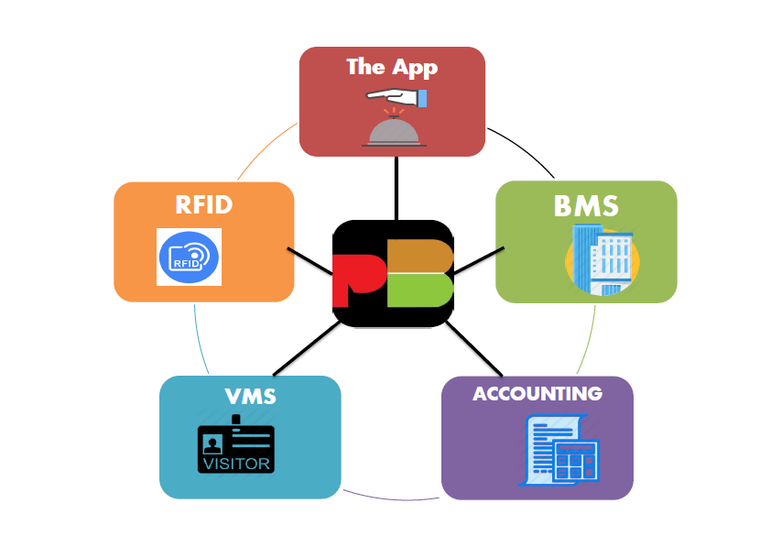

Slide 9



BUILDING MANAGEMENT SOFTWARE BMS
Accessibility
Web App Mobile App

Slide 10
BUILDING MANAGEMENT SOFTWARE BMS
Objective:
Control & maintaining the buildings/facilities
Increase assets/equipment lifespan
Increase residents comfort
Enhance the property value
Cost saving – eliminates unnecessary paperwork
Securing and protecting residents data
Optimize the operational efficiency of building

Slide 11
BUILDING MANAGEMENT SOFTWARE BMS
Features:
Residents Data Centre
Personal Assistant : To-do list reminder
Control & Monitoring Buildings/Community
Assets Maintaining And Scheduling For Servicing
Attendance with photo capturing and reports
Residents Notice Board : Push Notification to Mobile App
E-Notice : email sent for recording and monitoring
Minor Task : recording & monitoring of complains
Routine Task : monitoring of daily MO jobs
EGM/AGM Preparation checklist and reports
Staff/ Managing Agent Evaluation

Slide 12
BUILDING MANAGEMENT SOFTWARE BMS
Accessibility functions:
JMB / MC Access : Managing Agent Access : Residents Access :
> Accounts Monitoring > Setting-up info > Own Account Info
> Operation Monitoring > Operation management > Make payment online*
> Task Monitoring > Finance / Accounting > Facilities booking
> Asset Monitoring > Service Scheduling > Feedback/complain
> e-Notice Board > Notice board generating > Real-time push notification
> Report Monitoring > Staff Attendance report > Neighbour chatting
> Agent Evaluation > AGM/EGM Preparation > Contractors/service
> SOP Template > Generating Reports sourcing

Slide 13
BUILDING MANAGEMENT SOFTWARE BMS
Why choose us :
Tailor-made: For local Property solutions thru years of R&D and Property Management experience.
SOP Templates Property ever needed provided
Proven : Currently more than 60 property sites and growing.
Up-grading : FREE from time to time for stabilities
Data Security : USA based web hosting you can count on.

Slide 14

ACCOUNTING & FINANCING
Our complete accounting software are mean and designed for Strata Buildings, gives you a combination of powerful business modules. Create and deploy customized business software and custom auditor reports that work for you. Ensures data integrity, authenticated data access and online backups.

Slide 15

ACCOUNTING & FINANCING
Features:
Real-time Access Card Blocker (add-on), defaulter access card will be barred from entering by system automatically.
Online Payment Gateway (add-on) allows owners to pay using online banking /credit or debit cards and real-time system will un-barred the access card if is a defaulter even on weekends or Public Holidays
Online /Cloud-based : access your data anywhere with any connected mobile, tablet or computer
Un-limited users
Organizes your finances intelligently in one place
E-Invoicing : delivered to your customers electronically via email in just a few clicks
Track billings, purchases and collections
Maintain and keep your inventory up-to-date
Generate and print useful info with advanced analytic too

Slide 16

ACCOUNTING & FINANCING
Functions :
Generating Payment Vouchers
Automated Billing for maintenance charges, sinking fund, utilities, rental
Automated billing of Late Payment Interests
Automated generating Reminders for outstanding accounts
Auto knockoff for advance payments
Generating Receipts
General Ledger
Monthly and YTD Receipts and Payment
statement
Trial Balance & Bank Reconciliation
I&E Statement and Balance Sheet

Slide 17

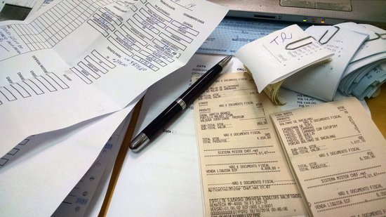
ACCOUNTING & FINANCING
Benefits :
Amazing Real-time features
Covered all aspects
Simple Interaction
No Installation require
Unlimited users all time
Large Data Handling
Complete Training Provided
User Friendly & Easy to Learn
High Speed Processing

Slide 18

ACCOUNTING & FINANCING
Why choose us :
Tailor-made : For local Property solutions thru years of R&D and Property Management experience.
Proven : Currently more than 60 property sites and growing.
Providing Real-time owners account info
Up-grading : FREE from time to time for stabilities
Data Security : USA based web hosting you can count on.
Affordable : Low monthly subscription for its functionality
Partner with most trusted Payment Gateway provider

Slide 19
VISIT MANAGEMENT SYSTEM VMS
Objective :
Enhance Building/ Gated community security
Improve Productivity
Protect Residents
Reducing / zeroing crimes rate
Enhance the property value
Cost saving – eliminates unnecessary paperwork
Efficiency Visitor, Contractor , E-hailing drivers
In/Out Processing & monitoring
Reporting Service

Slide 20
VISIT MANAGEMENT SYSTEM VMS
Accessibility
Local Based Mobile App

Slide 21
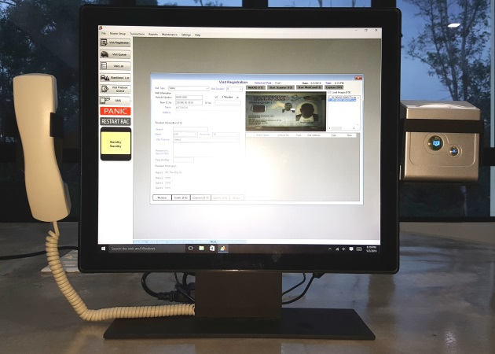
VISIT MANAGEMENT SYSTEM VMS
Functions :
Capture I/C, License or other card image and OCR during entry
Visitors entry/exit controlled by Barcode scanner
Easy retrieval of Visitors previous data by vehicle’s number/ IC No.
Call verification to residents via GSM Phone with just a click before any access to premises
Residents register contact is not shown at all time for data protection
Pre-register single /multiple visitors by mobile app
Pre-register of Contractor / Tutor for single or multiple entry
Pre-register of e-hailing/Taxi driver for pick-up and drop-off
Records & data of Manual barrier open in function for monitoring purpose.

Slide 22
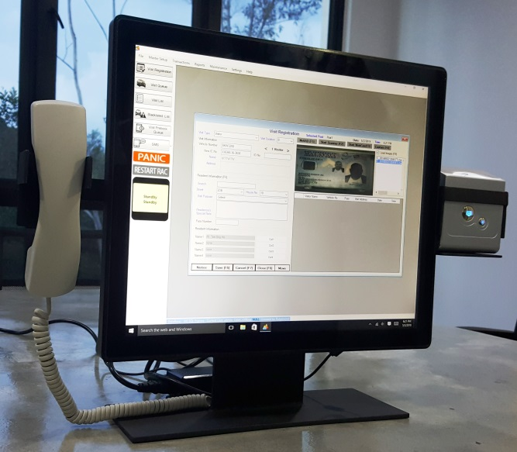
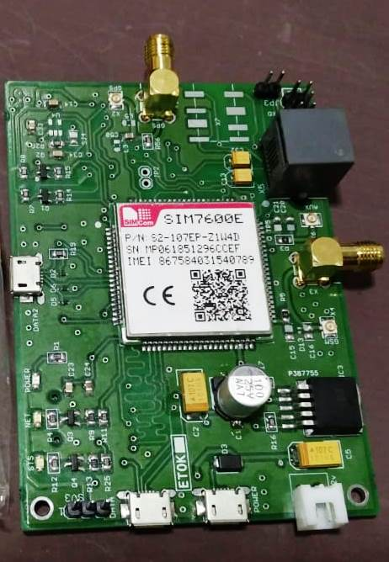
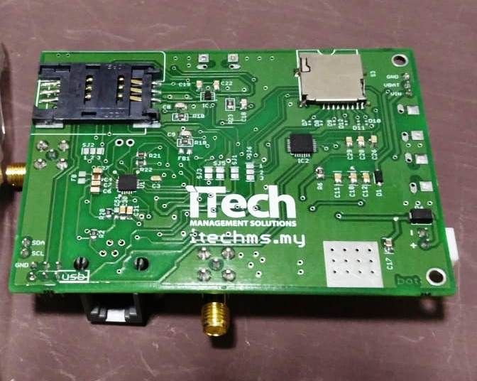
VISIT MANAGEMENT SYSTEM VMS
State-of-the-art Technology
Own development and patent GSM Board with voice recording on every call made to owners
Visitors entry/exit control by barcode reader reading barcode on Visitor Pass issued
Every single press of barrier gate Push button data is recorded for monitoring purpose

Slide 23
VISIT MANAGEMENT SYSTEM VMS
Why choose us:
Tailor-made : For local Property solutions thru years of R&D and Property Management experience.
Proven : Currently more than 60 property sites and growing.
One-off purchase, no contract commitment
Most complete features & functions Property VMS in the market
Sophisticated program you can count on
Providing latest heavy- duty embedded computer hardware and
licensed Windows 10 OS.
Data Security : Local based storage and wholly owned it.

Slide 24
RFID CAR STICKER ACCESS SYSTEM
Features :
Very low-cost stickers compare to other Long-range technology and
it is cheaper than a Proximity access cards.
No maintenance cost, unlike other long-range technology need to
change battery very frequently and high maintenance cost.
Cannot clone the stickers, unlike other access cards can be easily
clone.
High passage speed
Reliability in reading
License-free operation for UHF signal
Do not require Anti-Pass back feature

Slide 25


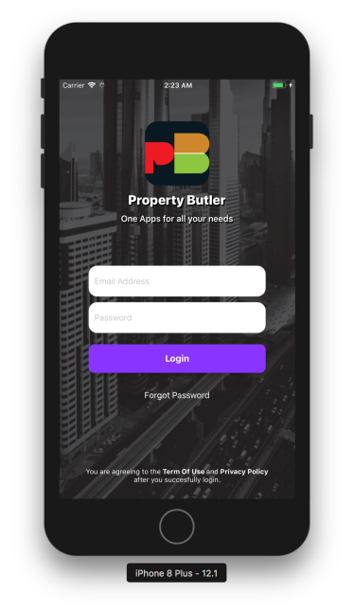
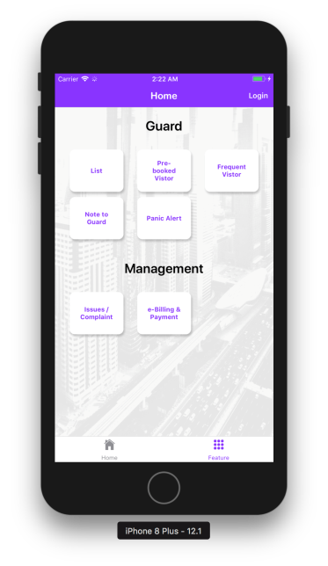
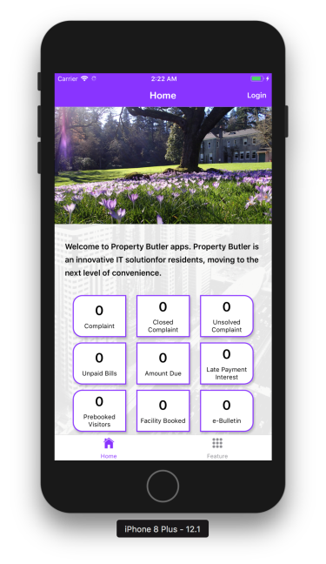
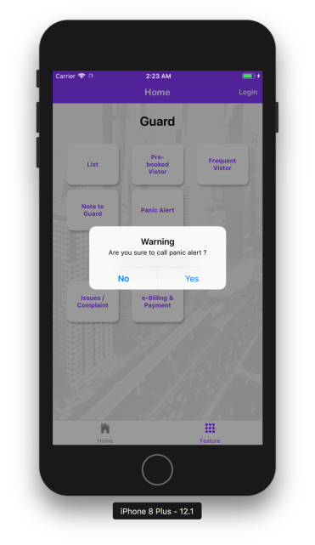
THE APP
Allow you to book the nearest available and best service providers in your region at a tap of a button.
The easiest and fastest way to hire service professional or even doctor to your home. All charges is transparent where a fixed service charges is applicable.
Every professional service providers is rigorously screened and rated (by you) to ensure you get the best service.

Slide 26



THE APP
FREE Mobile App

Slide 27
THE APP
Features :
Contractors/Renovators/I.D solutions
Housekeeping/ Laundry / Carwash solutions
Doctor-On-Call
Pest Control / Mover solutions
Pay utilities bills online/ Top-up
Online Shopping
Food Ordering
E-hailing / transport service bookings
Cashless Transaction

Slide 28










THE APP
SERVICES PROVIDER

Slide 29


PROPERTY BUTLER
WIN - WIN - WIN
SOLUTION
JMB / MC : | Easy Monitoring of Asset | Enhance Property Value | Agent Evaluation | 99% Data Retrievable
Managing Agent : | Easy Operating | Preventive Maintenance | All-in-one Integrated System | Staff Evaluation
Residents : | Own Account Monitoring | Prestigious Living | Easy Communication | One stop e-services

Slide 30
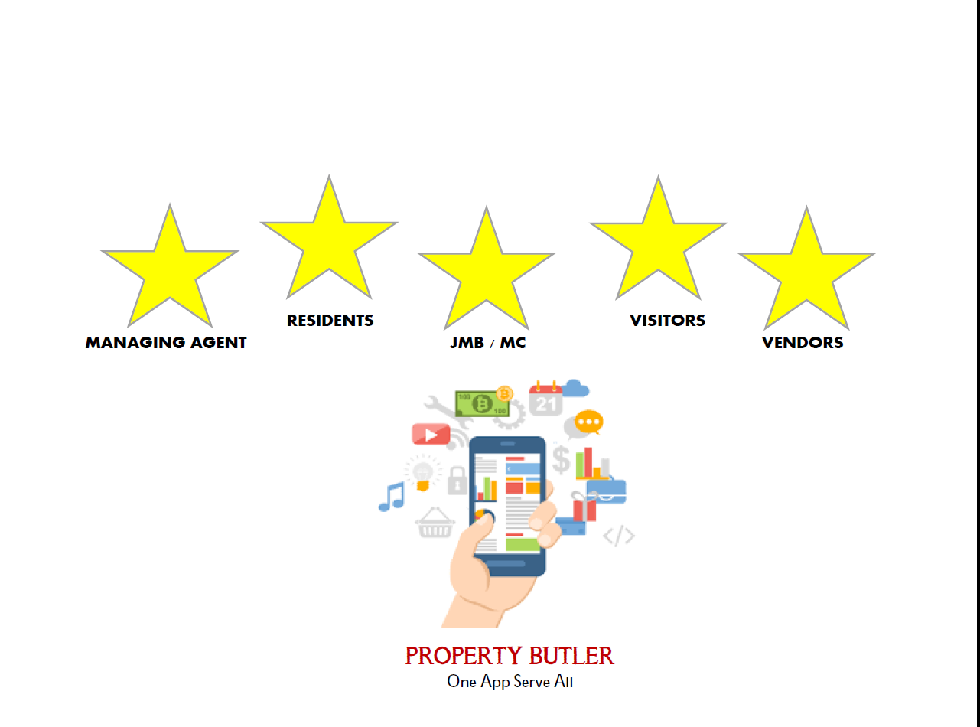
PROPERTY BUTLER

Slide 31


Thank You
Brought to you by :
www,itechms.my / jasonlim@itechms.my / +6019-314 8181

